Slide 1




Assignment 8:
Build an End-to-End IoT System
By Karla Chuprinski & Montserrat Alonso (Group 9)

Slide 2

Table of contents
01
02
03
04
Code Overview
Dataniz/MongoDB
Showcases System’s functionality
IoT data flow architecture & data results
Demo
Challenges/Feedback
Queries/Communication between Server & Client
Coding of Queries & Dataniz

Slide 3


Code Overview
01
Client.py | Server.py

Slide 4
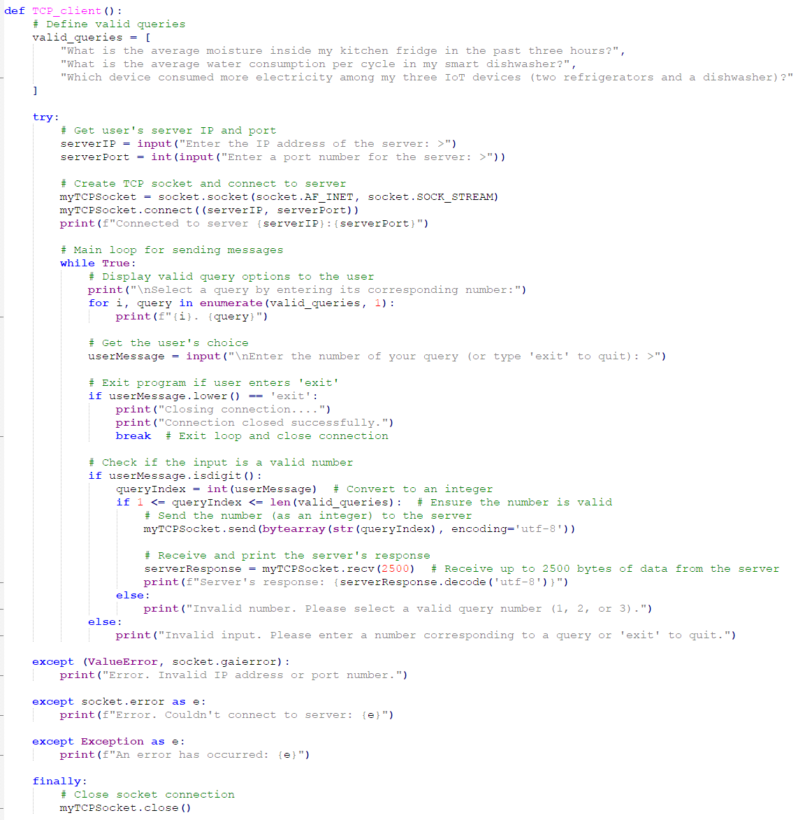
Client.py
Displays menu options for user
Validates user input
Establishes TCP Communication with the server
Sends user input to Server

Slide 5
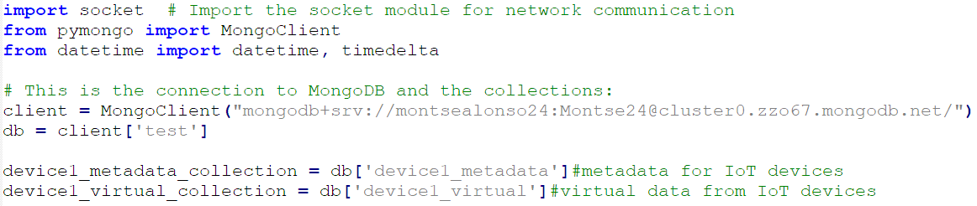
Server.py
Database
Import MongoDB
Connect server to MongoDB
Initialize collections
Notes:
The server retrieves data from 2 collections ( device1_metadata & device1_virtual) to process queries
Metadata and IoT sensor data are crucial for query-specific computations

Slide 6
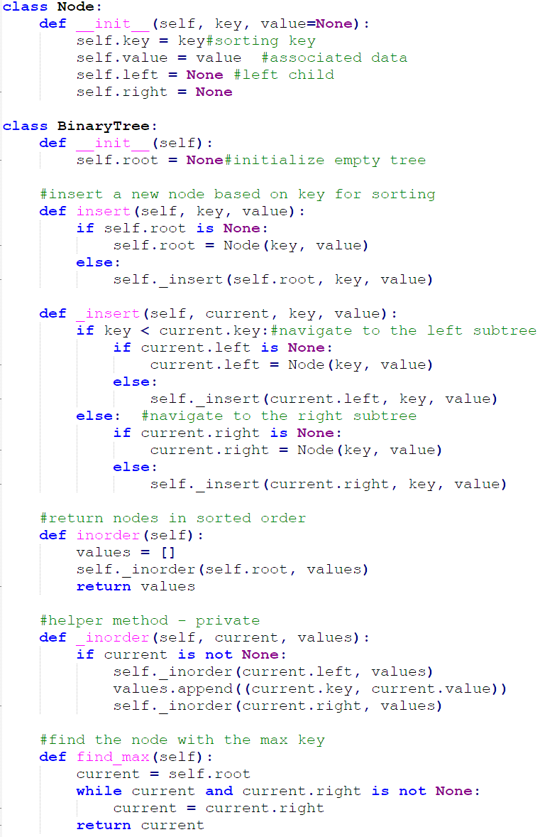
Server.py
Data Structure
Integration of binary tree
For fast & efficient insertion and sorting

Slide 7
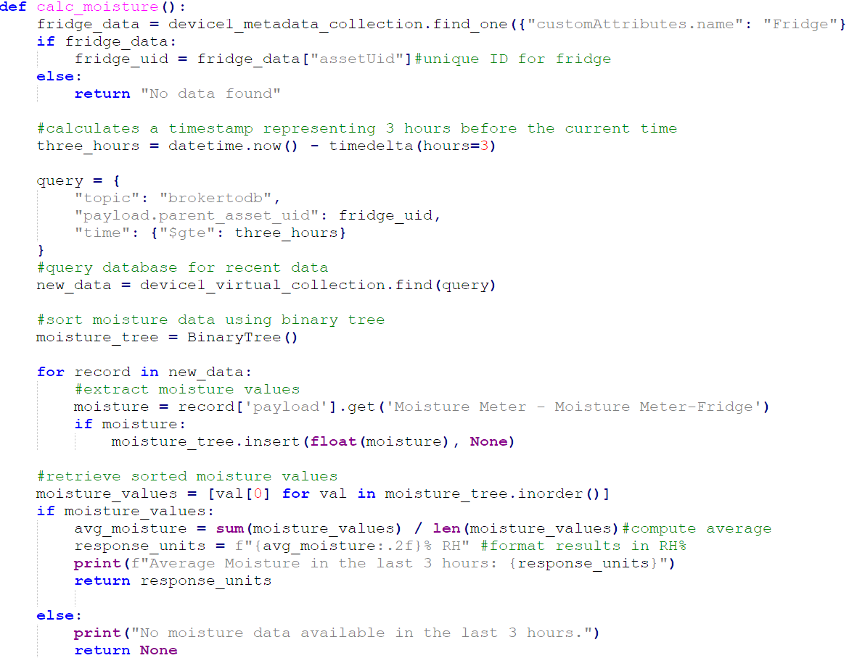
Server.py
Query 1
Retrieves data and calculates the average using in-order traversal of the BST

Slide 8
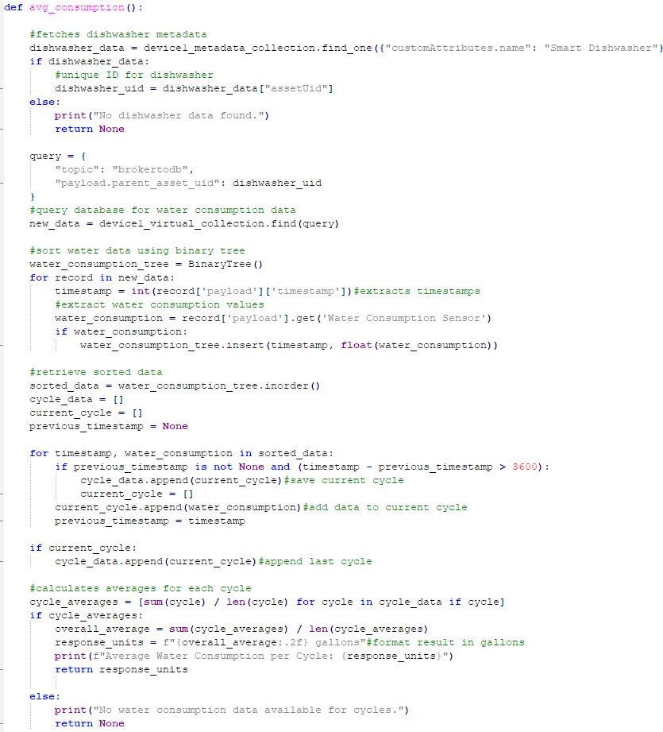
Server.py
Query 2
Groups water consumption data into cycles based on timestamps
Calculates if there’s a gap greater than 1 hour between the consecutive timestamps

Slide 9
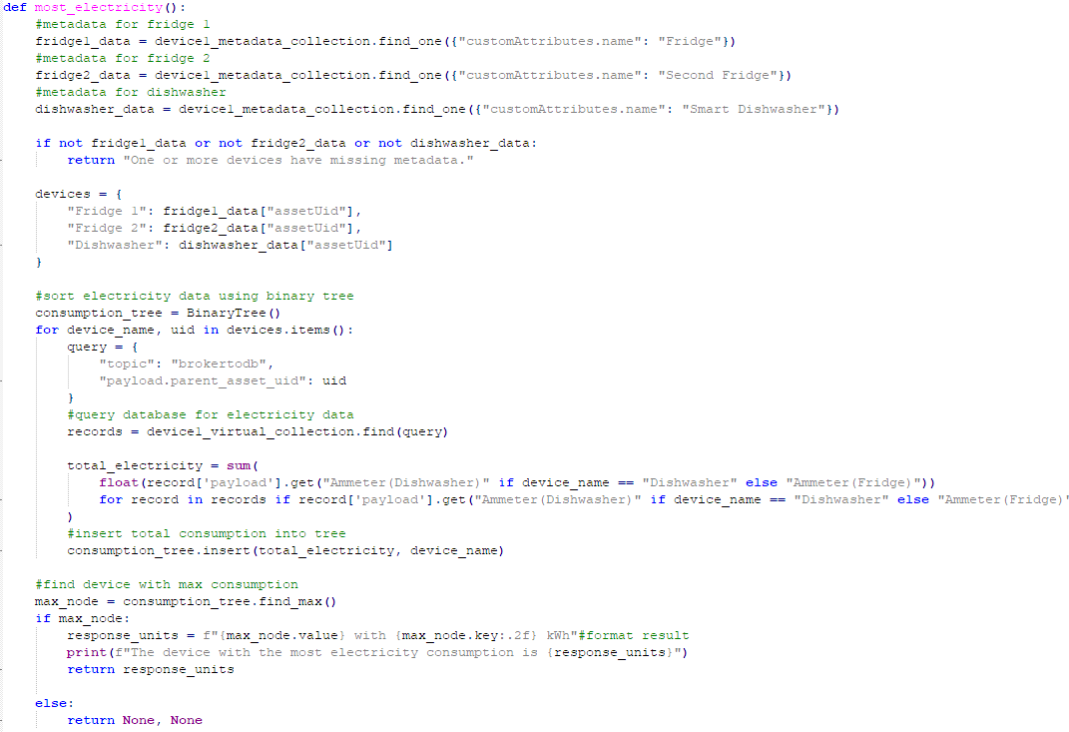
Server.py
Query 3
Sums up electricity usage for each device
Identifies the highest consumer
Looks to the rightmost node
Notes:
The nodes on the right are the highest values, the nodes on the left are the lowest values

Slide 10
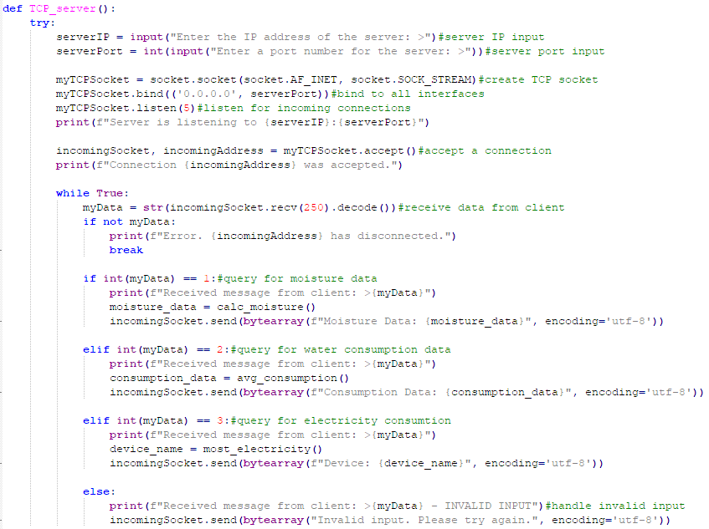
Server.py
Main
Establishes connection with client
Receives input from client
Based on user’s input it’ll go to the appropriate function and return value to client
Close connection if user disconnects

Slide 11
Dataniz/MongoDb
02
IoT Data Structure | Data Results

Slide 12
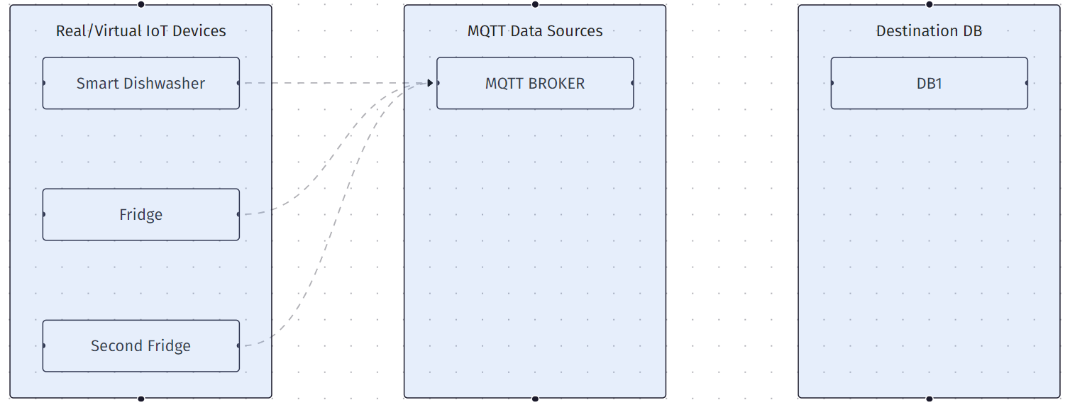
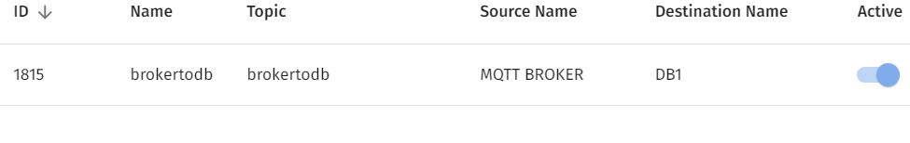
IoT Structure
Although there is no visual representation of a connection between MQTT and DB1, the image below showcases a connection

Slide 13
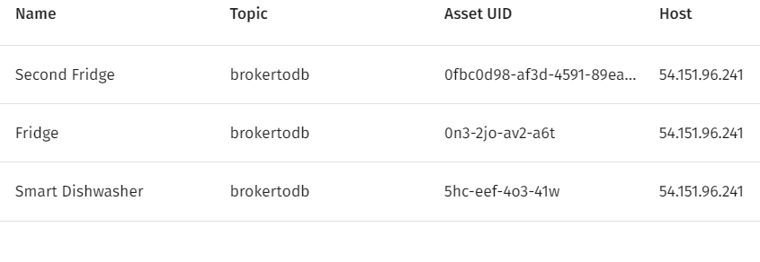
Virtual Devices
Each Device has their own Asset UID
Think of Private keys in Mongo!

Slide 14
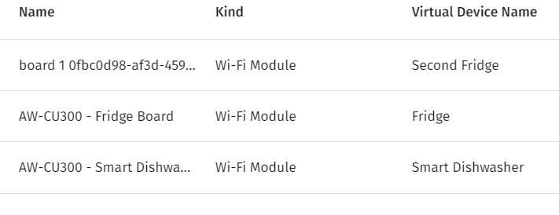
Virtual Boards
Each device will have their own virtual board

Slide 15
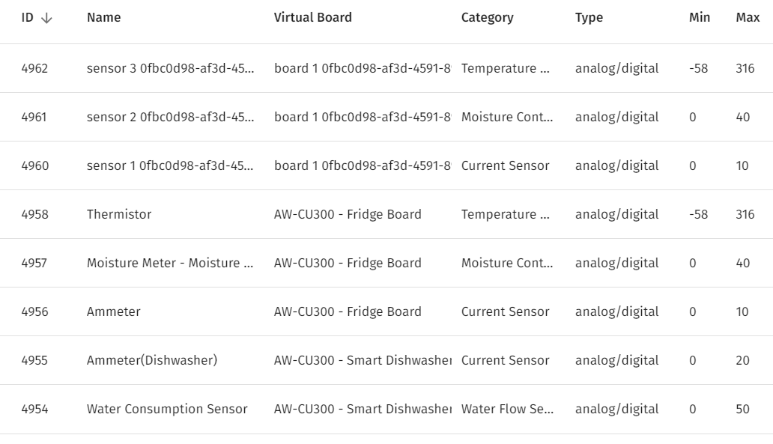
Virtual Sensors
Each device will have their own sensors
4962-4960: Duplicated Fridge device(Second Fridge)
4958-4956: First Fridge
4955-4954: Smart Dishwasher

Slide 16
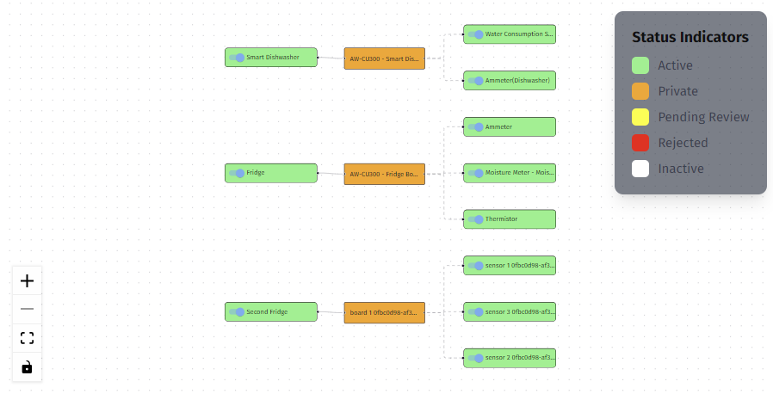
Generating Data View

Slide 17
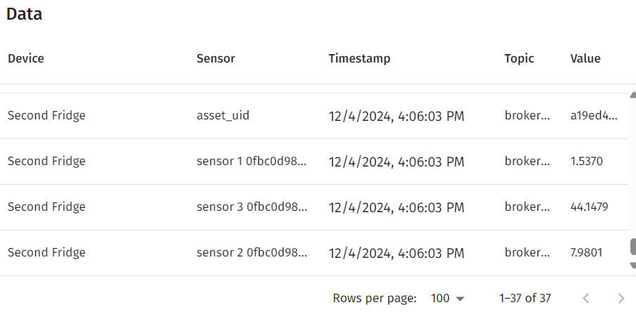
Virtual Data

Slide 18
Demo
03
Client.py | Server.py

Slide 19
Challenges/Feedback
04
Client.py | Server.py

Slide 20
Challenges
Had to redo Dataniz bec of sensors
Queries were challenging
Researching the Sensors

Slide 21
Feedback
Tutorial for Dataniz to enhance user friendly
A better way to edit sensors,device and boards
We had to start from scratch

Slide 22
Thanks!

